Slide 1
Few-Shot Representation Learning for Out-Of-Vocabulary Words
Ziniu Hu, Ting Chen, Kai-Wei Chang, Yizhou Sun
ACL 2019
Reporter: Lu Shuai
2019.6.19

Slide 2
Introduction
How can we learn accurate embedding vectors for OOV words during the inference time by observing their usages for only a few times?
Few-shot learning predicts the oracle embedding vector (defined as embedding trained with abundant observations) based on limited observations
Model-Agnostic Meta-Learning (MAML) adapt the learned model to the new corpus fast and robustly
Notes:
两种元学习的方法

Slide 3
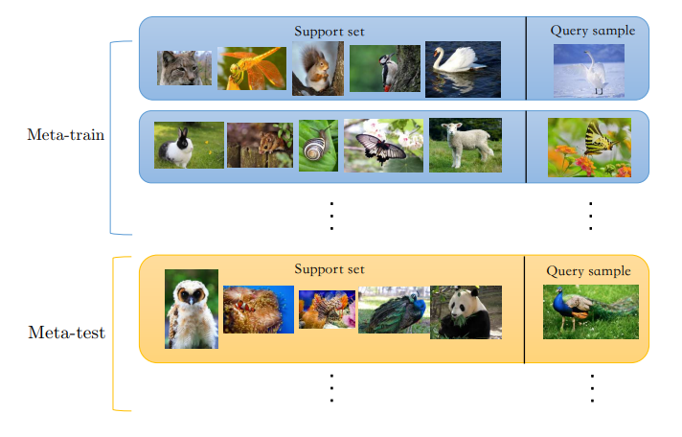
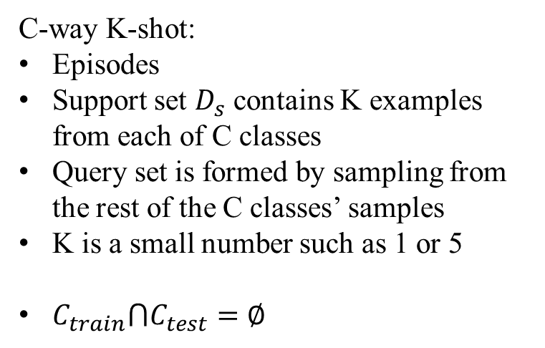
Few-shot learning
Train a model that can quickly adapt to a new task using only a few data- points and training iterations.
C-way K-shot:
Episodes
Support set $D_{s}$ contains K examples from each of C classes
Query set is formed by sampling from the rest of the C classes’ samples
K is a small number such as 1 or 5
$C_{train}⋂C_{test}=∅$
Notes:
最成功的应用之一 小样本学习 最初并不是为元学习而设计的

Slide 4
Meta-Learning
mate-learning = learning to learn
“fast adaptation on new training data”
Two categories of meta-learning (by the type of knowledge they learn):
Learn a metric function that embeds data in the same class closer to each other
Matching Networks
Prototypical Networks

Slide 5

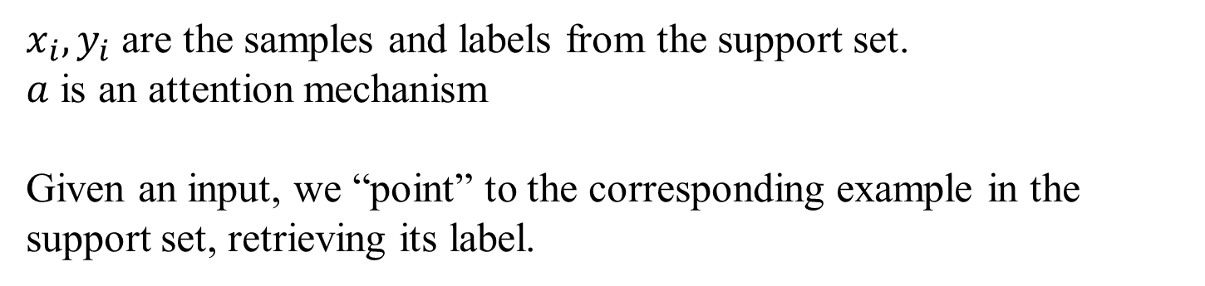
Matching Networks
$x_{i},y_{i}$ are the samples and labels from the support set.
$a$ is an attention mechanism
Given an input, we “point” to the corresponding example in the support set, retrieving its label.

Slide 6
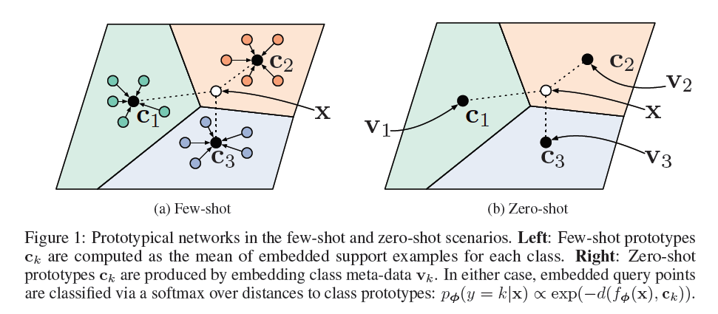
Prototypical Networks

Slide 7
Meta-Learning
mate-learning = learning to learn
“fast adaptation on new training data”
Two categories of meta-learning (by the type of knowledge they learn):
Learn a metric function that embeds data in the same class closer to each other
Matching Networks
Prototypical Networks
Learn a learning policy that can fast adapt to new concepts
MAML(A better weight initialization)
A better optimizer

Slide 8
Model-Agnostic Meta-Learning (MAML)
Adapt the learned model to the new corpus fast and robustly
The key idea: Train the model’s initial parameters such that the model has maximal performance on a new task after the parameters have been updated through one or more gradient steps computed with a small amount of data from that new task.
Learning to fine-tune

Slide 9
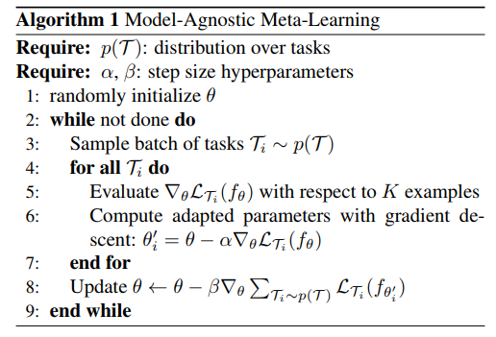


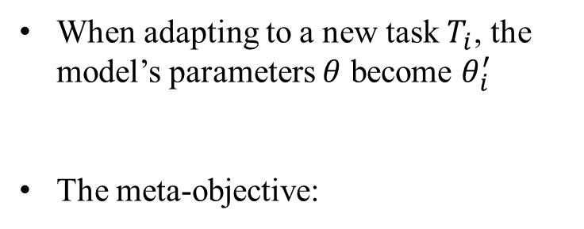
Model-Agnostic Meta-Learning (MAML)
When adapting to a new task $T_{i}$, the model’s parameters $θ$ become $θ_{i}^{′}$
The meta-objective:
Model-Agnostic Meta-Learning for Fast Adaptation of Deep Networks

Slide 10
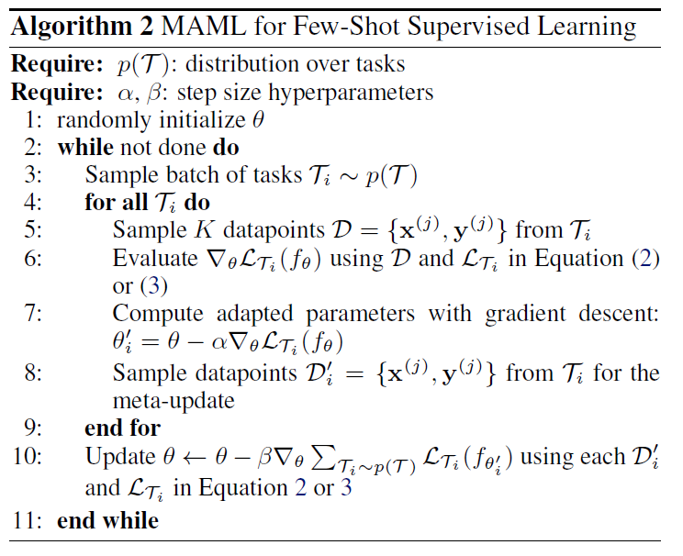
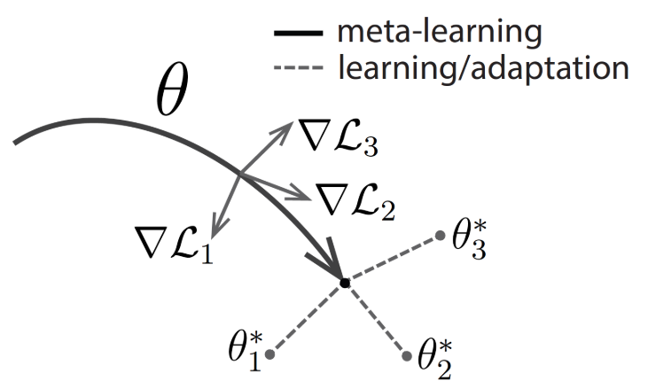
Model-Agnostic Meta-Learning (MAML)
Model-Agnostic Meta-Learning for Fast Adaptation of Deep Networks

Slide 11

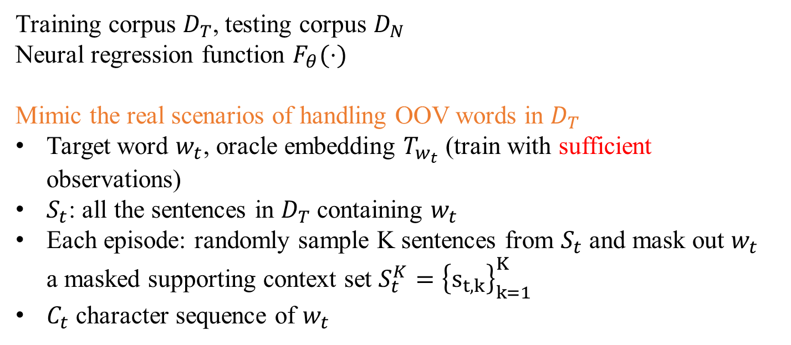
The Few-Shot Regression Framework
Training corpus $D_{T}$, testing corpus $D_{N}$
Neural regression function $F_{θ}(⋅)$
Mimic the real scenarios of handling OOV words in $D_{T}$
Target word $w_{t}$, oracle embedding $T_{w_{t}}$ (train with sufficient observations)
$S_{t}$: all the sentences in $D_{T}$ containing $w_{t}$
Each episode: randomly sample K sentences from $S_{t}$ and mask out $w_{t}$ a masked supporting context set $S_{t}^{K}={\left\{s_{t,k}\right\}}_{k=1}^{K}$
$C_{t}$ character sequence of $w_{t}$

Slide 12
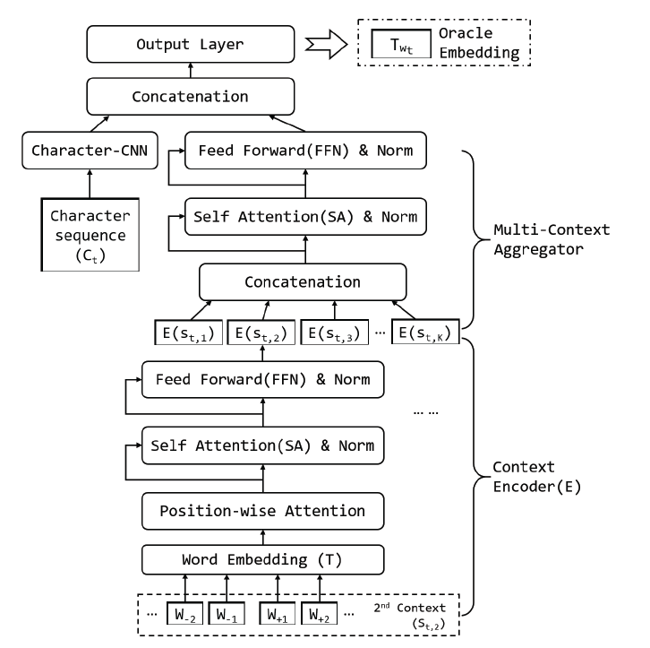

Hierarchical Context Encoding (HiCE)
$F_{θ}(⋅)$

Slide 13

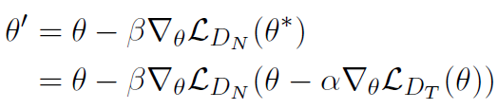
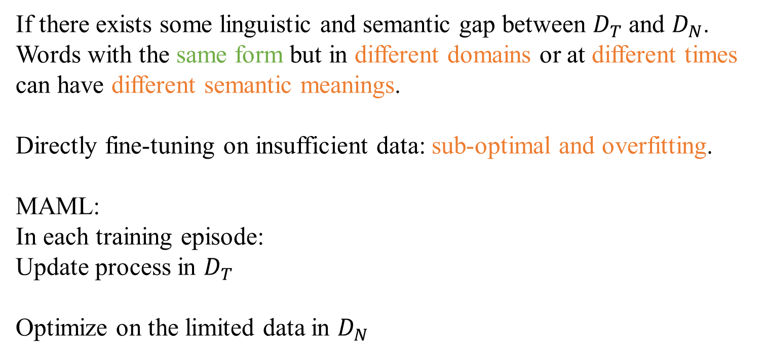
Fast and Robust Adaptation with MAML
If there exists some linguistic and semantic gap between $D_{T}$ and $D_{N}$.
Words with the same form but in different domains or at different times can have different semantic meanings.
Directly fine-tuning on insufficient data: sub-optimal and overfitting.
MAML:
In each training episode:
Update process in $D_{T}$
Optimize on the limited data in $D_{N}$

Slide 14
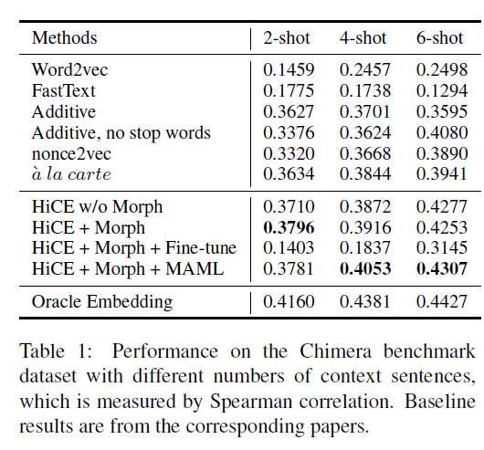
Experiments
Intrinsic Evaluation: Evaluate OOV embeddings on a benchmark dataset

Slide 15
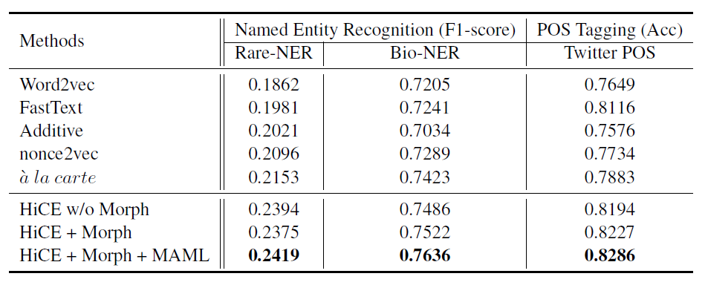
Experiments
Extrinsic Evaluation: Evaluate OOV embeddings on downstream tasks
(1) NER (2)POS tagging

Slide 16
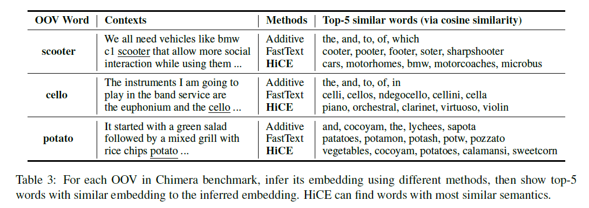
Case Study

